Slide 1

2023 로봇스터디 사전 교육 2주차
영상처리 기본

Slide 2

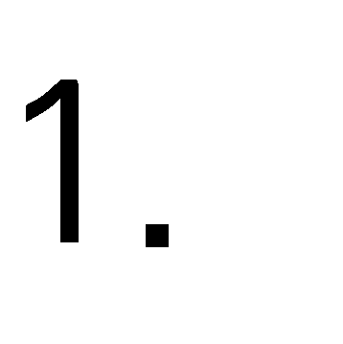


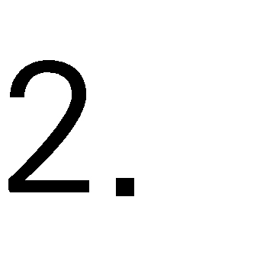


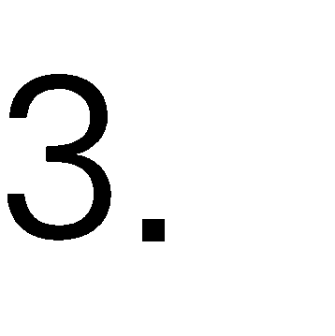

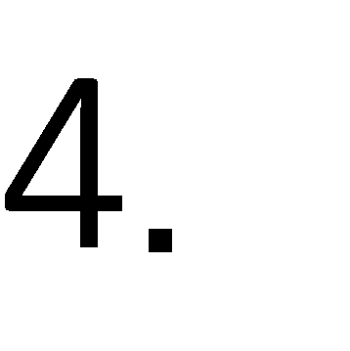




Slide 3
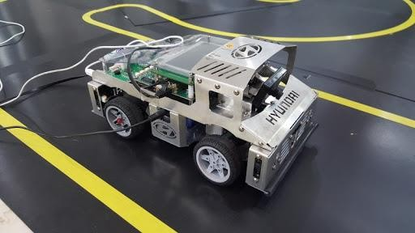
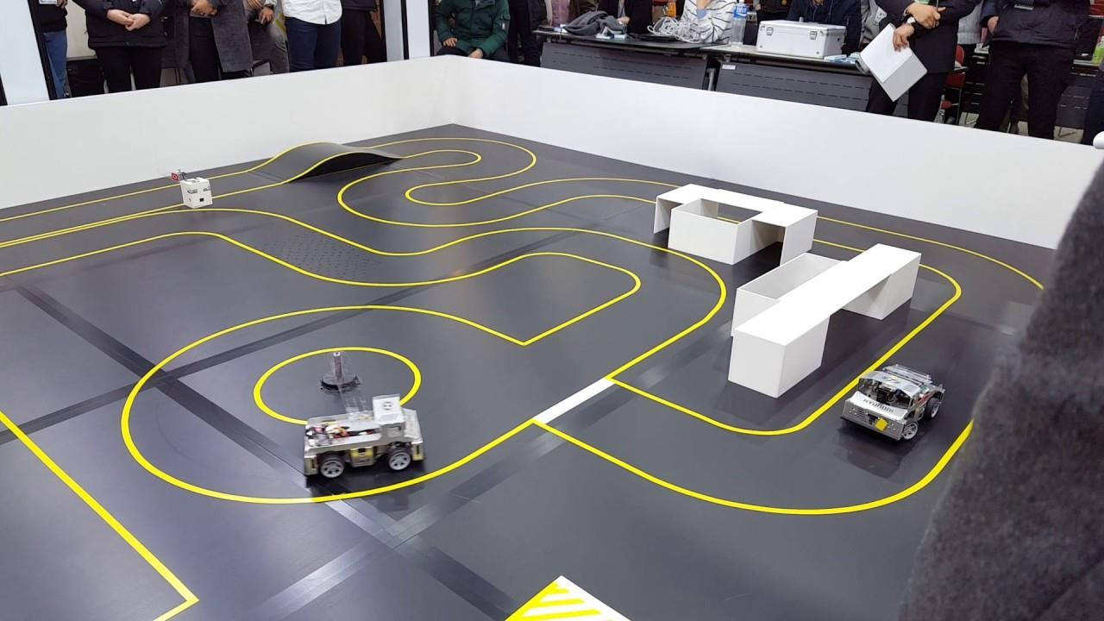

Slide 4
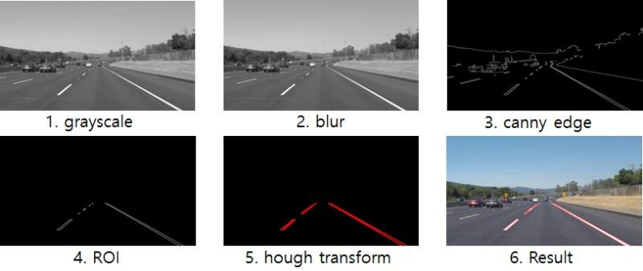

Slide 6



Slide 7
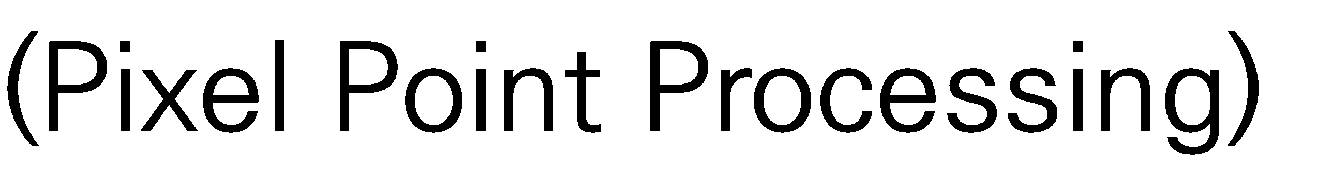






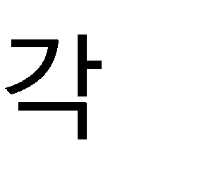








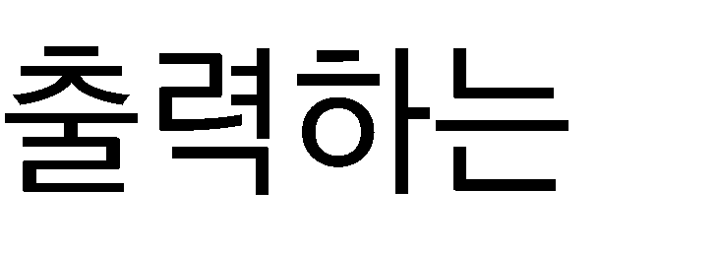



Slide 8


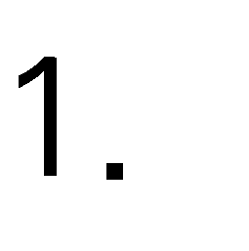









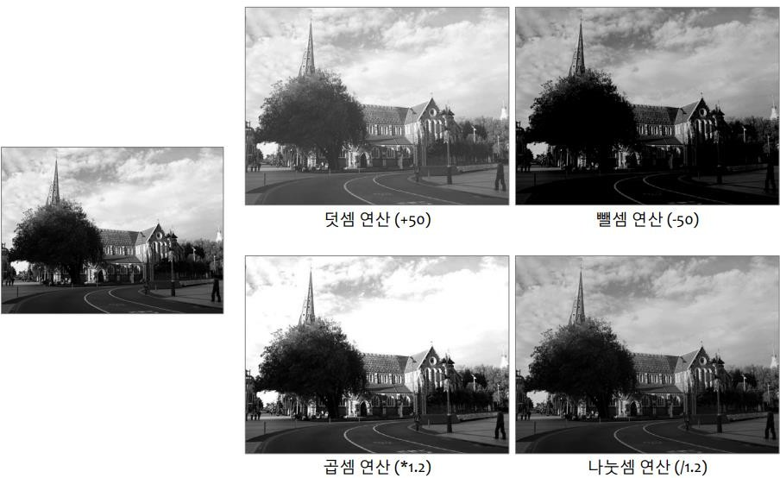

Slide 9
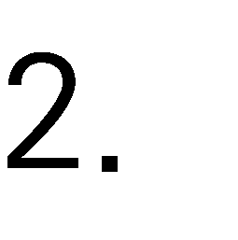

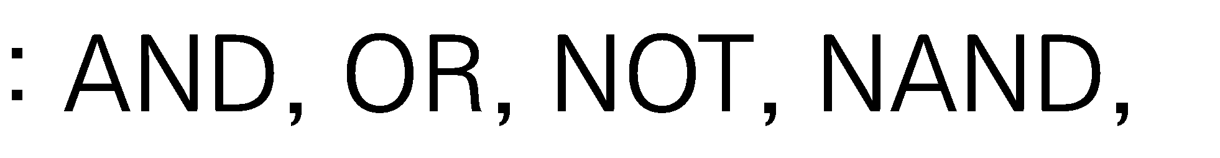
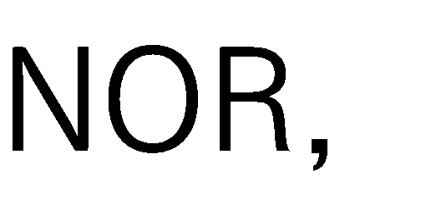
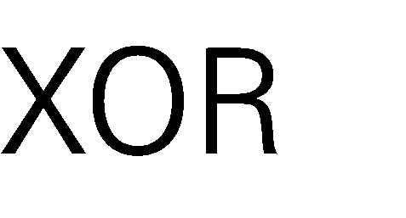

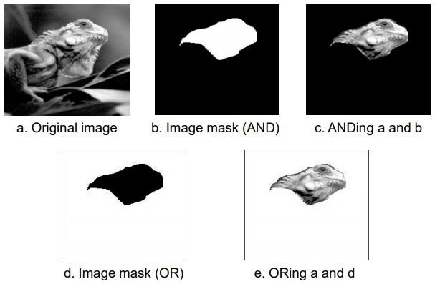

Slide 10
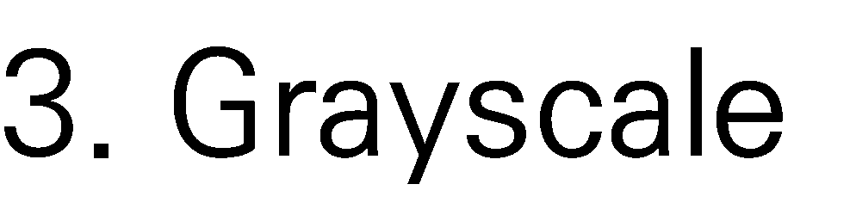


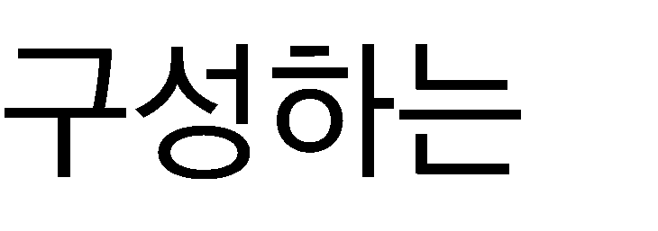

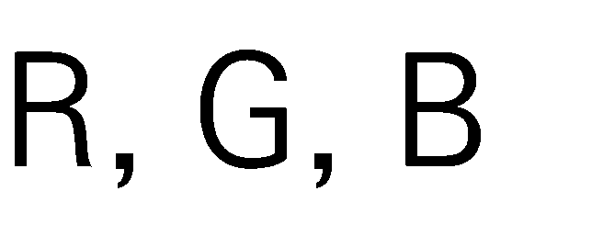









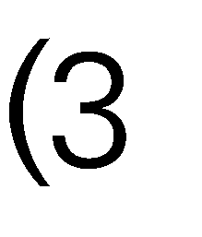

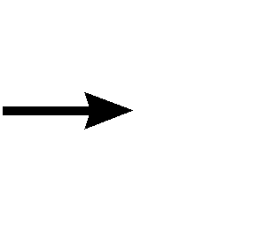
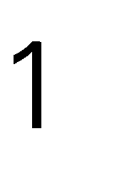

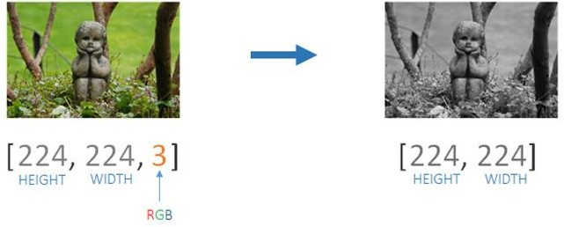

Slide 11






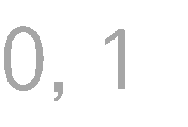






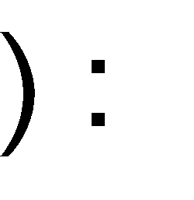



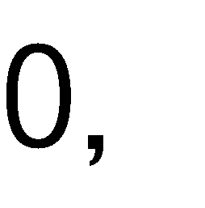

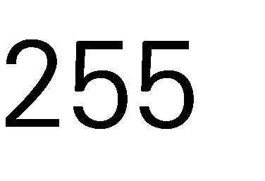









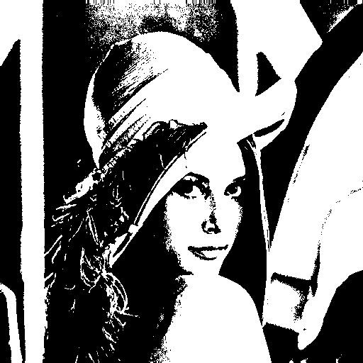

Slide 12


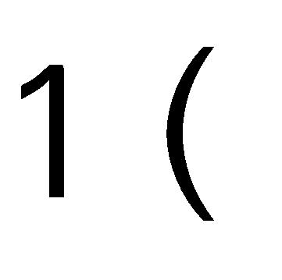


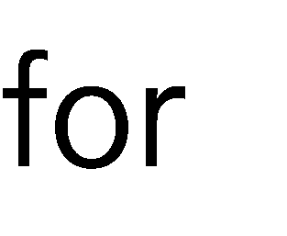



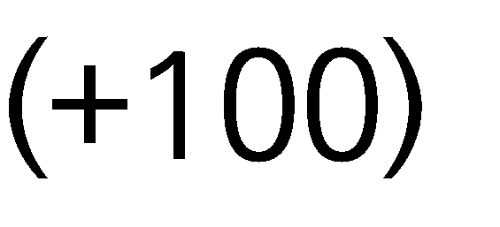
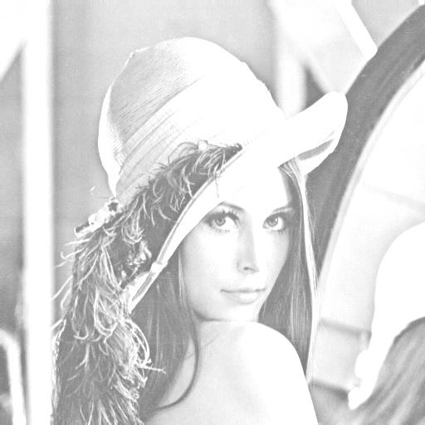

Slide 13
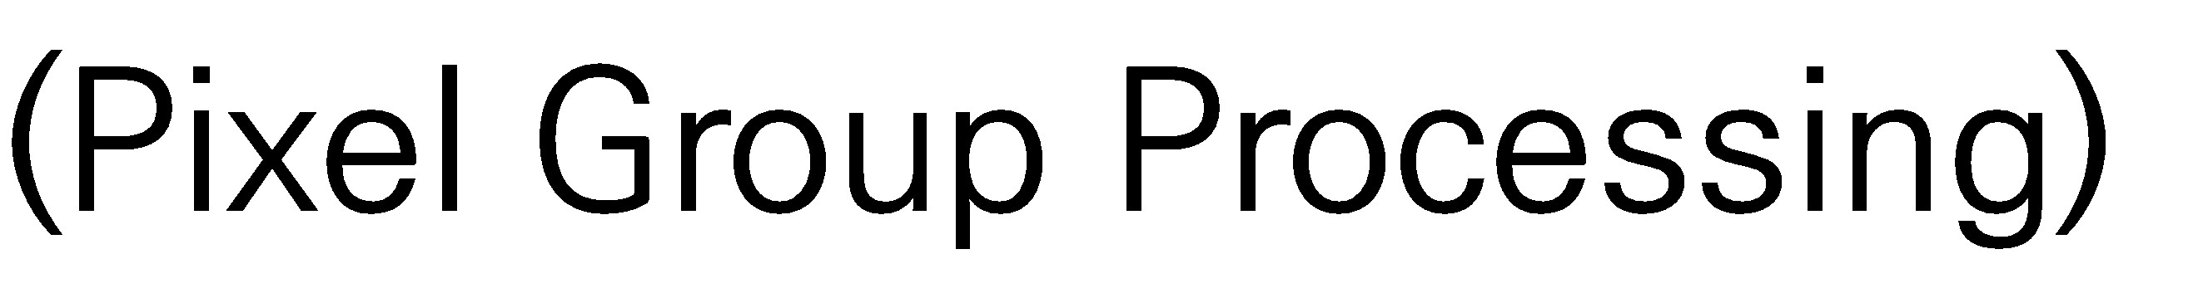







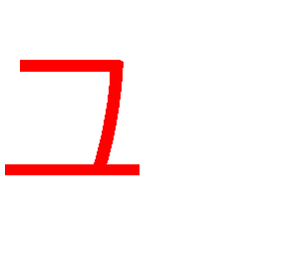









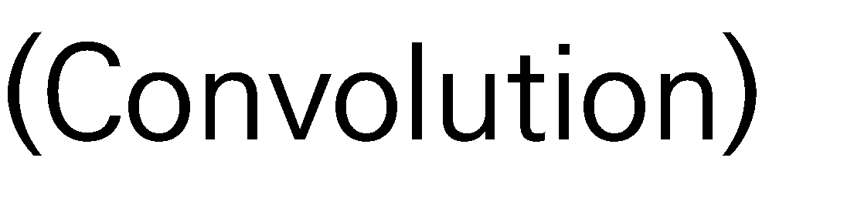


•
•

Slide 14



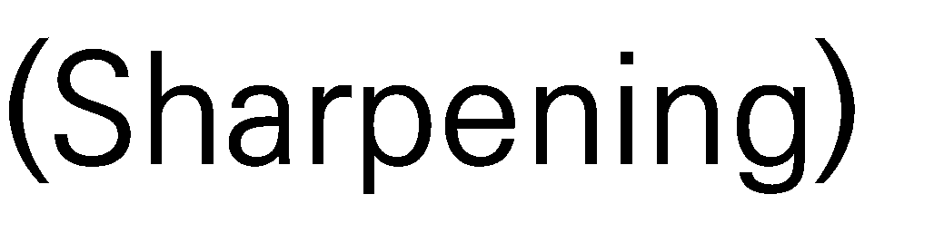










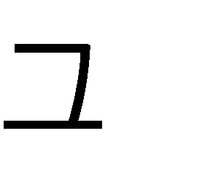


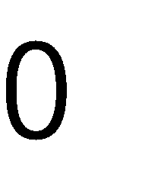
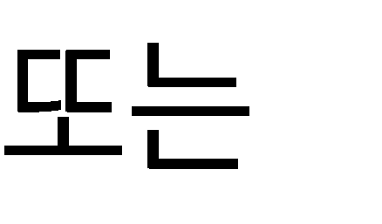

Slide 15
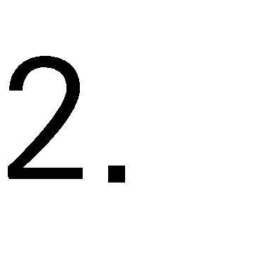

Slide 16



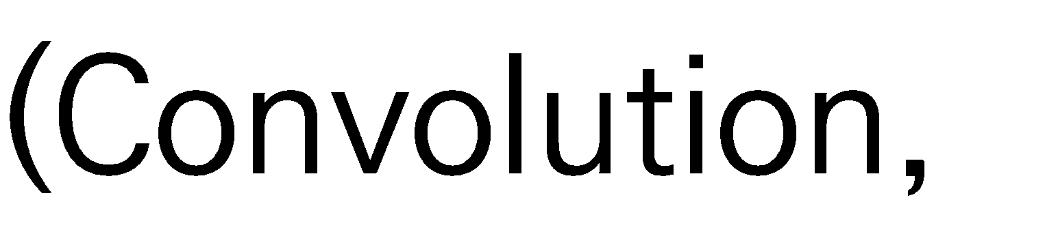


















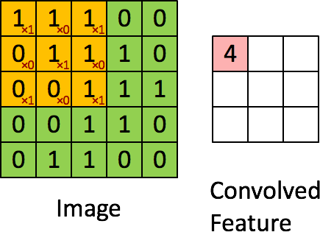

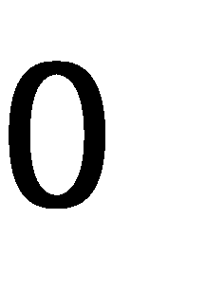

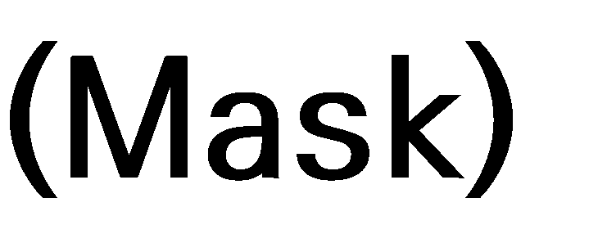

Slide 17











Slide 18

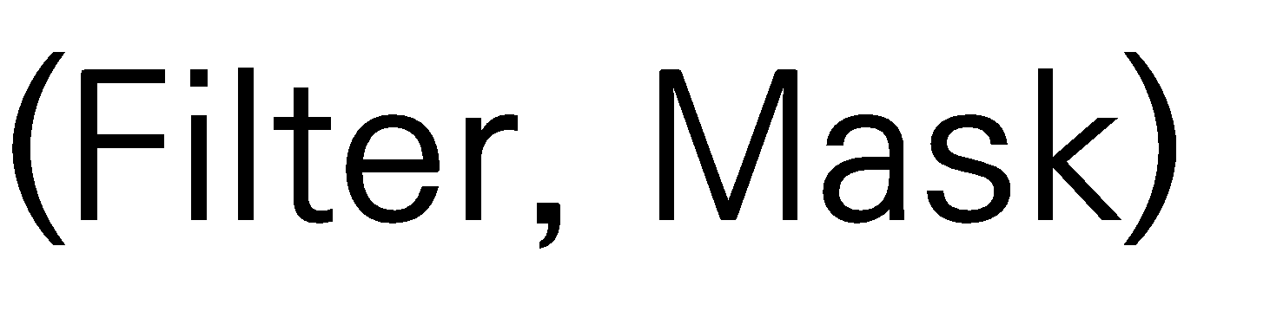




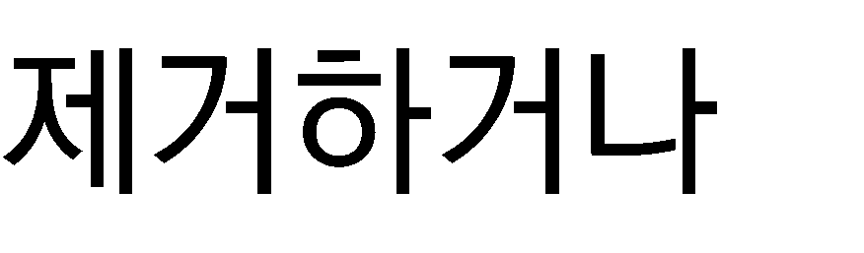






Slide 19
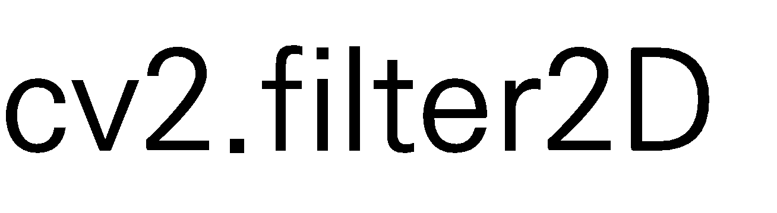

















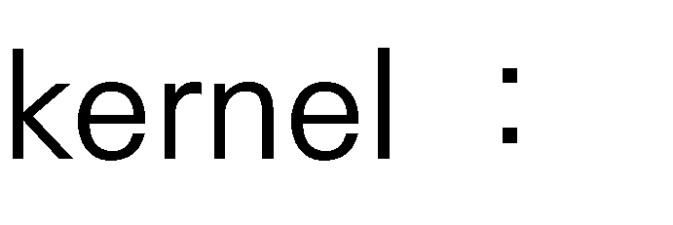



Slide 21



















Slide 22







Slide 23


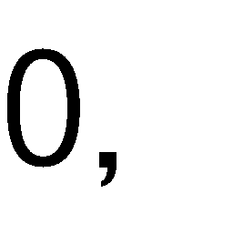



Slide 24












Slide 25






Slide 26







Slide 27






















Slide 28

















































Slide 30



















Slide 31














1/9 | 1/9 | 1/9
1/9 | 1/9 | 1/9
1/9 | 1/9 | 1/9
73 | 142 | 156
52 | 85 | 120
64 | 102 | 85
1/16 | 2/16 | 1/16
2/16 | 4/16 | 2/16
1/16 | 2/16 | 1/16

Slide 32



















1/9 | 1/9 | 1/9
1/9 | 1/9 | 1/9
1/9 | 1/9 | 1/9

Slide 33



1 | 1 | 1 | 1 | 1
1 | 1 | 1 | 1 | 1
1 | 1 | 1 | 1 | 1
1 | 1 | 1 | 1 | 1
1 | 1 | 1 | 1 | 1
1 | 1 | 1
1 | 1 | 1
1 | 1 | 1
1
9
1
25

Slide 34








1 | 1 | 1 | 1 | 1
1 | 1 | 1 | 1 | 1
1 | 1 | 1 | 1 | 1
1 | 1 | 1 | 1 | 1
1 | 1 | 1 | 1 | 1
1 | 1 | 1
1 | 1 | 1
1 | 1 | 1
1
9
1
25

Slide 35

















73 | 142 | 156
52 | 85 | 120
64 | 102 | 85

Slide 36






73 | 142 | 156 | 52 | 82 | 120 | 64 | 102 | 85
73 | 142 | 156
52 | 82 | 120
64 | 102 | 85
52 | 64 | 73 | 82 | 85 | 102 | 120 | 142 | 156
73 | 142 | 156
52 | 85 | 120
64 | 102 | 85

Slide 37










Slide 38









1 | 2 | 1
2 | 4 | 2
1 | 2 | 1
1
16

Slide 39













Slide 40

1 | 4 | 6 | 4 | 1
4 | 16 | 24 | 16 | 4
6 | 24 | 36 | 24 | 6
4 | 16 | 24 | 16 | 4
1 | 4 | 6 | 4 | 1
1 | 2 | 1
2 | 4 | 2
1 | 2 | 1
1
1
16
256

Slide 41


1 | 4 | 6 | 4 | 1
4 | 16 | 24 | 16 | 4
6 | 24 | 36 | 24 | 6
4 | 16 | 24 | 16 | 4
1 | 4 | 6 | 4 | 1
1 | 2 | 1
2 | 4 | 2
1 | 2 | 1
1
1
16
256

Slide 42

















Slide 43













Slide 44












Slide 45
0 | -1 | 0
-1 | 5 | -1
0 | -1 | 0
0 | -2 | 0
-2 | 5 | -2
0 | -2 | 0
-1 | -1 | -1
-1 | 9 | -1
-1 | -1 | -1

Slide 46

0 | -1 | 0
-1 | 5 | -1
0 | -1 | 0
0 | -2 | 0
-2 | 5 | -2
0 | -2 | 0
-1 | -1 | -1
-1 | 9 | -1
-1 | -1 | -1

Slide 47











































Slide 48












Slide 49


